Slide 1

Apache Pig
(Some) Slides borrowed from
Adam Shook

Slide 2
Objectives
Develop understanding of Pig’s data model
Understand basics of PigLatin

Slide 3
What Is Pig?
Developed by Yahoo! and a top level Apache project
Immediately makes data on a cluster available to non-Java programmers via Pig Latin – a dataflow language
Interprets Pig Latin and generates MapReduce jobs that run on the cluster
Enables easy data summarization, ad-hoc reporting and querying, and analysis of large volumes of data
Pig interpreter runs on a client machine – no administrative overhead required

Slide 4
Pig Terms
All data in Pig one of four types:
Atom is a simple data value - stored as a string but can be used as either a string or a number
Tuple is a data record consisting of a sequence of "fields"
Each field is a piece of data of any type (atom, tuple or bag)
Bag is a set of tuples (also referred to as a ‘Relation’)
The concept of a table
Map is a map from keys that are string literals to values that can be any data type
The concept of a hash map

Slide 5
Pig Capabilities
Support for
Grouping
Joins
Filtering
Aggregation
Extensibility
Support for User Defined Functions (UDF’s)
Leverages the same massive parallelism as native MapReduce

Slide 6
Pig Basics
Pig is a client application
No cluster software is required
Interprets Pig Latin scripts to MapReduce jobs
Parses Pig Latin scripts
Performs optimization
Creates execution plan
Submits MapReduce jobs to the cluster

Slide 7
Execution Modes
Pig has two execution modes
Local Mode - all files are installed and run using your local host and file system
MapReduce Mode - all files are installed and run on a Hadoop cluster and HDFS installation
Interactive
By using the Grunt shell by invoking Pig on the command line
$ pig
grunt>
Batch
Run Pig in batch mode using Pig Scripts and the "pig" command
$ pig –f id.pig –p <param>=<value> ...

Slide 8
Pig Latin
Pig Latin scripts are generally organized as follows
A LOAD statement reads data
A series of “transformation” statements process the data
A STORE statement writes the output to the filesystem
A DUMP statement displays output on the screen
Logical vs. physical plans:
All statements are stored and validated as a logical plan
Once a STORE or DUMP statement is found the logical plan is executed

Slide 9
Example Pig Script
-- Load the content of a file into a pig bag named ‘input_lines’
input_lines = LOAD 'CHANGES.txt' AS (line:chararray);
-- Extract words from each line and put them into a pig bag named ‘words’
words = FOREACH input_lines GENERATE FLATTEN(TOKENIZE(line)) AS word;
-- filter out any words that are just white spaces
filtered_words = FILTER words BY word MATCHES '\\w+';
-- create a group for each word
word_groups = GROUP filtered_words BY word;
-- count the entries in each group
word_count = FOREACH word_groups GENERATE COUNT(filtered_words) AS count, group AS word;
-- order the records by count
ordered_word_count = ORDER word_count BY count DESC;
-- Store the results ( executes the pig script )
STORE ordered_word_count INTO 'output’;

Slide 10
Basic “grunt” Shell Commands
Help is available
$ pig -h
Pig supports HDFS commands
grunt> pwd
put, get, cp, ls, mkdir, rm, mv, etc.

Slide 11
About Pig Scripts
Pig Latin statements grouped together in a file
Can be run from the command line or the shell
Support parameter passing
Comments are supported
Inline comments '--'
Block comments /* */

Slide 12
Simple Data Types
Type | Description
int | 4-byte integer
long | 8-byte integer
float | 4-byte (single precision) floating point
double | 8-byte (double precision) floating point
bytearray | Array of bytes; blob
chararray | String (“hello world”)
boolean | True/False (case insensitive)
datetime | A date and time
biginteger | Java BigInteger
bigdecimal | Java BigDecimal

Slide 13
Complex Data Types
Type | Description
Tuple | Ordered set of fields (a “row / record”)
Bag | Collection of tuples (a “resultset / table”)
Map | A set of key-value pairs Keys must be of type chararray

Slide 14
Pig Data Formats
BinStorage
Loads and stores data in machine-readable (binary) format
PigStorage
Loads and stores data as structured, field delimited text files
TextLoader
Loads unstructured data in UTF-8 format
PigDump
Stores data in UTF-8 format
YourOwnFormat!
via UDFs

Slide 15
Loading Data Into Pig
Loads data from an HDFS file
var = LOAD 'employees.txt';
var = LOAD 'employees.txt' AS (id, name, salary);
var = LOAD 'employees.txt' using PigStorage()
AS (id, name, salary);
Each LOAD statement defines a new bag
Each bag can have multiple elements (atoms)
Each element can be referenced by name or position ($n)
A bag is immutable
A bag can be aliased and referenced later

Slide 16
Input And Output
STORE
Writes output to an HDFS file in a specified directory
grunt> STORE processed INTO 'processed_txt';
Fails if directory exists
Writes output files, part-[m|r]-xxxxx, to the directory
PigStorage can be used to specify a field delimiter
DUMP
Write output to screen
grunt> DUMP processed;

Slide 17
Relational Operators
FOREACH
Applies expressions to every record in a bag
FILTER
Filters by expression
GROUP
Collect records with the same key
ORDER BY
Sorting
DISTINCT
Removes duplicates

Slide 18
FOREACH . . .GENERATE
Use the FOREACH …GENERATE operator to work with rows of data, call functions, etc.
Basic syntax:
alias2 = FOREACH alias1 GENERATE expression;
Example:
DUMP alias1;
(1,2,3) (4,2,1) (8,3,4) (4,3,3) (7,2,5) (8,4,3)
alias2 = FOREACH alias1 GENERATE col1, col2;
DUMP alias2;
(1,2) (4,2) (8,3) (4,3) (7,2) (8,4)

Slide 19
FILTER. . .BY
Use the FILTER operator to restrict tuples or rows of data
Basic syntax:
alias2 = FILTER alias1 BY expression;
Example:
DUMP alias1;
(1,2,3) (4,2,1) (8,3,4) (4,3,3) (7,2,5) (8,4,3)
alias2 = FILTER alias1 BY (col1 == 8) OR (NOT (col2+col3 > col1));
DUMP alias2;
(4,2,1) (8,3,4) (7,2,5) (8,4,3)

Slide 20
GROUP. . .ALL
Use the GROUP…ALL operator to group data
Use GROUP when only one relation is involved
Use COGROUP with multiple relations are involved
Basic syntax:
alias2 = GROUP alias1 ALL;
Example:
DUMP alias1;
(John,18,4.0F) (Mary,19,3.8F) (Bill,20,3.9F) (Joe,18,3.8F)
alias2 = GROUP alias1 BY col2;
DUMP alias2;
(18,{(John,18,4.0F),(Joe,18,3.8F)})
(19,{(Mary,19,3.8F)})
(20,{(Bill,20,3.9F)})

Slide 21
ORDER. . .BY
Use the ORDER…BY operator to sort a relation based on one or more fields
Basic syntax:
alias = ORDER alias BY field_alias [ASC|DESC];
Example:
DUMP alias1;
(1,2,3) (4,2,1) (8,3,4) (4,3,3) (7,2,5) (8,4,3)
alias2 = ORDER alias1 BY col3 DESC;
DUMP alias2;
(7,2,5) (8,3,4) (1,2,3) (4,3,3) (8,4,3) (4,2,1)

Slide 22
DISTINCT. . .
Use the DISTINCT operator to remove duplicate tuples in a relation.
Basic syntax:
alias2 = DISTINCT alias1;
Example:
DUMP alias1;
(8,3,4) (1,2,3) (4,3,3) (4,3,3) (1,2,3)
alias2= DISTINCT alias1;
DUMP alias2;
(8,3,4) (1,2,3) (4,3,3)

Slide 23
Relational Operators
FLATTEN
Used to un-nest tuples as well as bags
INNER JOIN
Used to perform an inner join of two or more relations based on common field values
OUTER JOIN
Used to perform left, right or full outer joins
SPLIT
Used to partition the contents of a relation into two or more relations
SAMPLE
Used to select a random data sample with the stated sample size

Slide 24
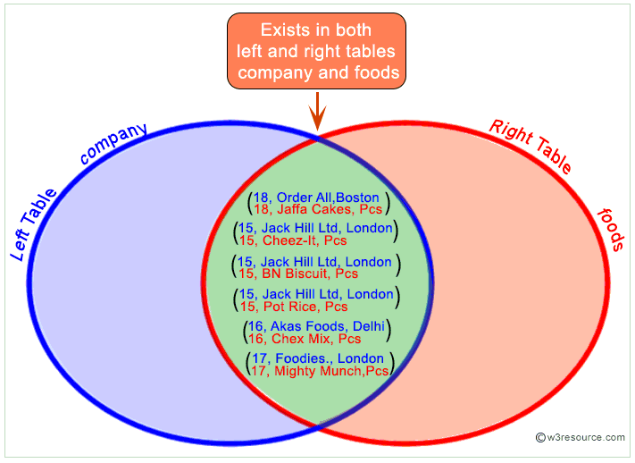
INNER JOIN

Slide 25
INNER JOIN. . .
Use the JOIN operator to perform an inner, equi-join join of two or more relations based on common field values
The JOIN operator always performs an inner join
Inner joins ignore null keys
Filter null keys before the join
JOIN and COGROUP operators perform similar functions
JOIN creates a flat set of output records
COGROUP creates a nested set of output records

Slide 26
INNER JOIN Example
DUMP Alias1;
(1,2,3)
(4,2,1)
(8,3,4)
(4,3,3)
(7,2,5)
(8,4,3)
DUMP Alias2;
(2,4)
(8,9)
(1,3)
(2,7)
(2,9)
(4,6)
(4,9)
Join Alias1 by Col1 to Alias2 by Col1
Alias3 = JOIN Alias1 BY Col1, Alias2 BY Col1;
Dump Alias3;
(1,2,3,1,3)
(4,2,1,4,6)
(4,3,3,4,6)
(4,2,1,4,9)
(4,3,3,4,9)
(8,3,4,8,9)
(8,4,3,8,9)

Slide 27
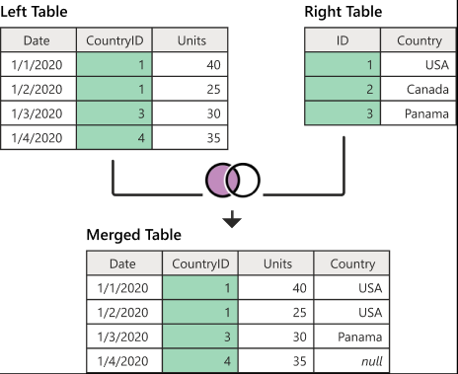
LEFT OUTER JOINS

Slide 28
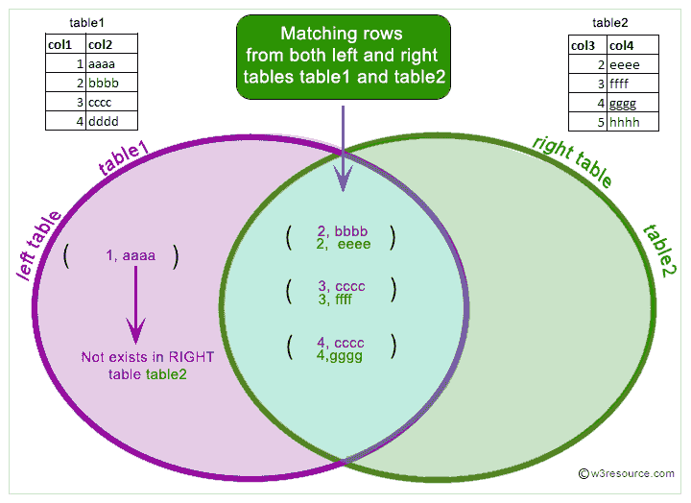
LEFT OUTER JOINS

Slide 29
OUTER JOIN. . .
Use the OUTER JOIN operator to perform left, right, or full outer joins
Pig Latin syntax closely adheres to the SQL standard
The keyword OUTER is optional
keywords LEFT, RIGHT and FULL will imply left outer, right outer and full outer joins respectively
Outer joins will only work provided the relations which need to produce nulls (in the case of non-matching keys) have schemas
Outer joins will only work for two-way joins
To perform a multi-way outer join perform multiple two-way outer join statements

Slide 30
OUTER JOIN Examples
Left Outer Join
A = LOAD 'a.txt' AS (n:chararray, a:int);
B = LOAD 'b.txt' AS (n:chararray, m:chararray);
C = JOIN A by $0 LEFT OUTER, B BY $0;
Full Outer Join
A = LOAD 'a.txt' AS (n:chararray, a:int);
B = LOAD 'b.txt' AS (n:chararray, m:chararray);
C = JOIN A BY $0 FULL OUTER, B BY $0;

Slide 31
User-Defined Functions
Natively written in Java, packaged as a jar file
Other languages include Jython, JavaScript, Ruby, Groovy, and Python
Register the jar with the REGISTER statement
Optionally, alias it with the DEFINE statement
REGISTER /src/myfunc.jar;
A = LOAD 'students';
B = FOREACH A GENERATE myfunc.MyEvalFunc($0);

Slide 32
DEFINE
DEFINE can be used to work with UDFs and also streaming commands
Useful when dealing with complex input/output formats
/* read and write comma-delimited data */
DEFINE Y 'stream.pl' INPUT(stdin USING PigStreaming(','))
OUTPUT(stdout USING PigStreaming(','));
A = STREAM X THROUGH Y;
/* Define UDFs to a more readable format */
DEFINE MAXNUM org.apache.pig.piggybank.evaluation.math.MAX;
A = LOAD ‘student_data’ AS (name:chararray, gpa1:float, gpa2:double);
B = FOREACH A GENERATE name, MAXNUM(gpa1, gpa2);
DUMP B;

Slide 33
References
http://pig.apache.org

